Slide 1
Deadlock
Deadlock, Deadlock handling methods(AVOIDANCE,DETECTION,RECOVERY)
Week#9-10

Slide 2
Deadlock
Permanent blocking of a set of processes that either compete for system resources or communicate with each other
No efficient solution
Involve conflicting needs for resources by two or more processes

Slide 3
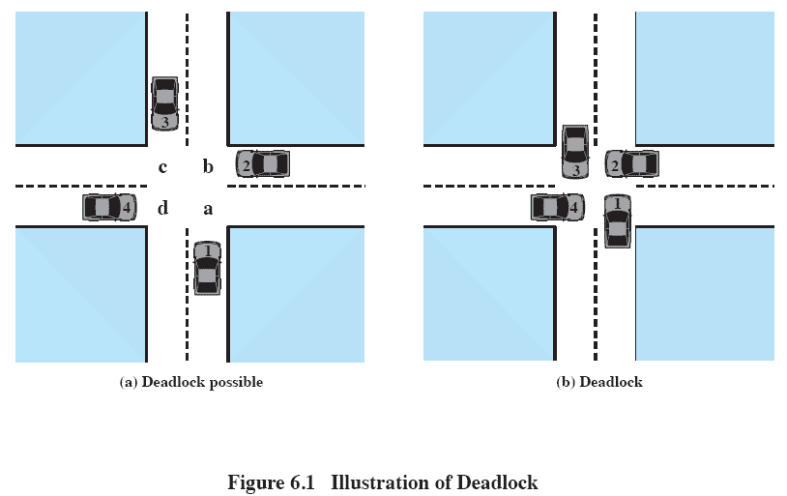
Deadlock

Slide 4
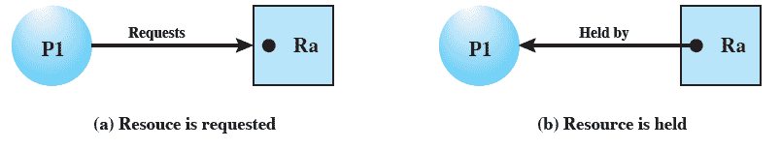
Resource Allocation Graphs
Directed graph that depicts a state of the system of resources and processes

Slide 5
Conditions for Deadlock
Mutual exclusion
Only one process may use a resource at a time
Hold-and-wait
A process may hold allocated resources while awaiting assignment of others
No preemption
No resource can be forcibly removed form a process holding it
Circular wait
A closed chain of processes exists, such that each process holds at least one resource needed by the next process in the chain

Slide 6
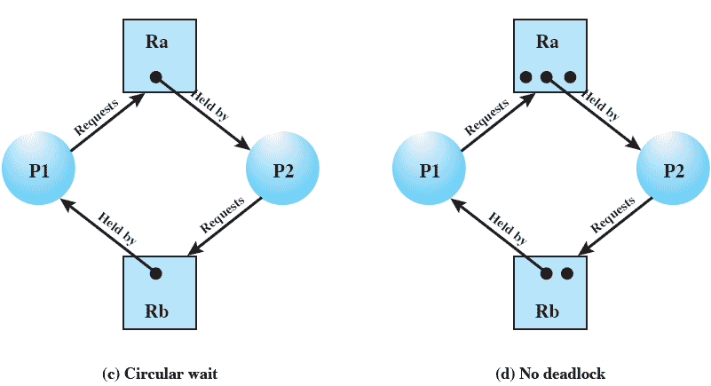
Resource Allocation Graphs

Slide 7
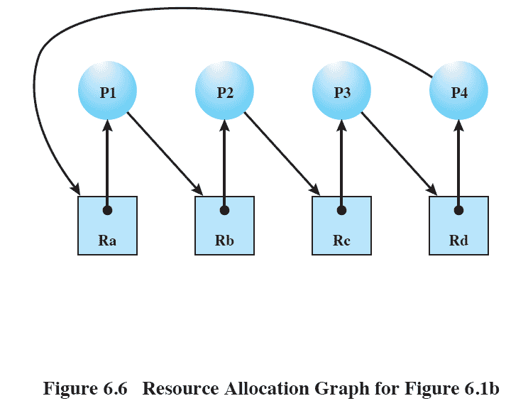
Resource Allocation Graphs

Slide 8
Possibility of Deadlock
Mutual Exclusion
No preemption
Hold and wait

Slide 9
Existence of Deadlock
Mutual Exclusion
No preemption
Hold and wait
Circular wait

Slide 10
Deadlock Prevention
Mutual Exclusion
Must be supported by the OS
Hold and Wait
Require a process request all of its required resources at one time

Slide 11
Deadlock Prevention
No Preemption
If a further request for a resource is denied; Process must release resources it already has and request them all together again
OS may preempt a process to require it to release its resources
Only possible if processes have different priorities
Circular Wait
Define a linear ordering of resource types
The processes are only allowed to request resources in a numerical order

Slide 12
Deadlock Avoidance
A decision is made dynamically whether the current resource allocation request will, if granted, potentially lead to a deadlock
Requires knowledge of future process requests

Slide 13
Two Approaches to Deadlock Avoidance
Do not start a process if its demands might lead to deadlock
Do not grant an incremental resource request to a process if this allocation might lead to deadlock

Slide 14
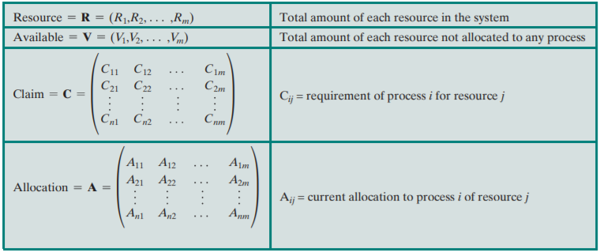
Process Initiation Denial
Consider a system of m processes and n different types of resources, lets define following vectors and matrices:

Slide 15
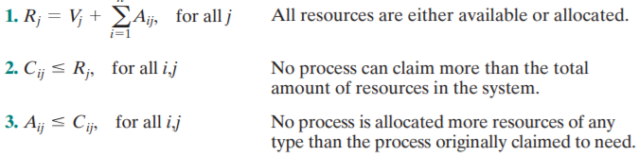

Contd.
Given that the following relationships hold;
Start a new process only if the maximum claim of all the processes plus the new process can be met or else don’t start it.
Problem: It assumes the worst that is all processes will make their maximum claims together.

Slide 16
Resource Allocation Denial
Referred to as the banker’s algorithm
State of the system is the current allocation of resources to process
Safe state is where there is at least one sequence that does not result in deadlock
Unsafe state is a state, where there is no such safe sequence
Refer to classwork for problem solution

Slide 17
Dijkstra’s Banker’s Algorithm
When we refer to resources in deadlock avoidance, we mean resources of the same type. The banker's Algorithm is easily extendable to pools of resources of several different types. For example, consider the allocation of a quantity, t, of identical tape drives. An operating system shares a fixed number of equivalent tape drives, t, among a fixed number of users, u. Each user specifies in advance the maximum number of tape drives he or she will need during the execution of his or her job on the system. The operating system will accept a user's request if that user's maximum need for tape drives does not exceed t. A user may obtain or release tape drives one by one. Sometimes, a user may have to wait to obtain an additional tape drive, but the operating system guarantees a finite wait. The current number of tape drives al located to a user will never exceed that user's stated maximum need. If the operating system is able to satisfy a user's maximum need for tape drives, then the user guarantees that the tape drives will be used and released to the operating system within finite time. The current state of the system is called safe if it is possible for the operating system to allow all current users to complete their jobs within a finite time. If not, then the current system state is called unsafe.

Slide 18
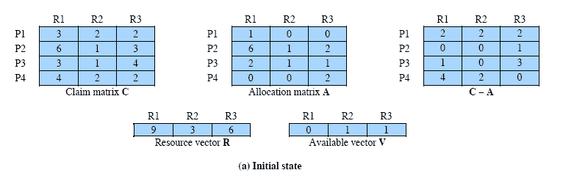
Determination of a Safe State

Slide 19
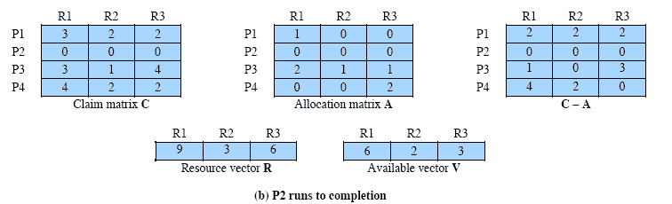
Determination of a Safe State

Slide 20
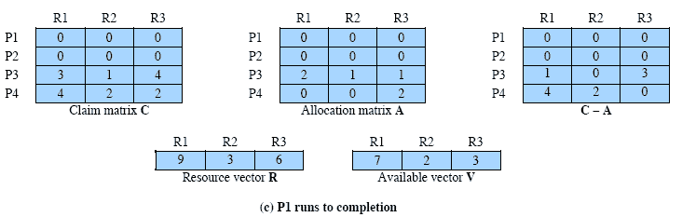
Determination of a Safe State

Slide 21
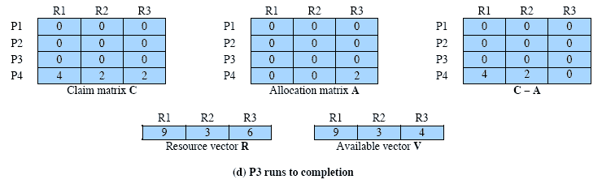
Determination of a Safe State

Slide 22
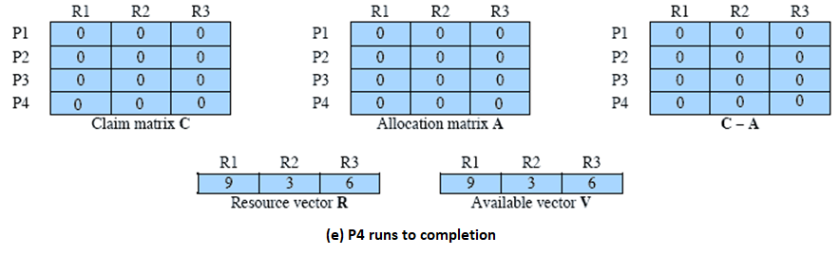
Determination of a Safe State

Slide 23
Determination of a Safe State
Safe Sequence: <P2,P1,P3,P4>
Initial State is a safe state
Another question answered by this algorithm could be:
If P2 request for Resource R3; Should it be granted?

Slide 24
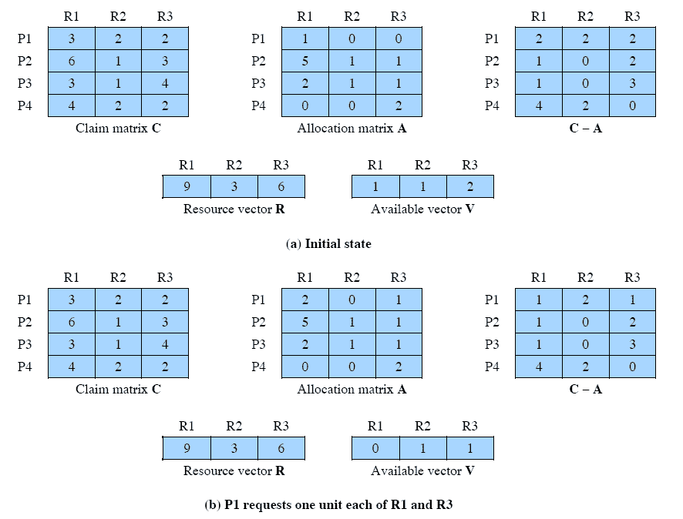
Determination of an Unsafe State
Unsafe State

Slide 25
Contd:
No requests can be granted after granting P1’s request
This means allocating R1 and R3 to P1 results in an unsafe state; hence, in order to avoid deadlock request of P1 should be denied.

Slide 26
Deadlock Avoidance - Considerations
Maximum resource requirement must be stated in advance
Processes under consideration must be independent; no synchronization requirements
There must be a fixed number of resources to allocate
No process may exit while holding resources

Slide 27
Deadlock Detection
Deadlock detection is the process of actually determining that a deadlock exists, and of identifying the processes and resources involved in the deadlock. Deadlock detection algorithms are generally used in systems in which the first three necessary conditions for deadlock to occur are allowed. These algorithms then determine if a circular wait exists.
The use of deadlock detection algorithm involves certain run-time overhead.
Banker’s algorithm is one of the methods used for detecting deadlock
Notes:
Same Banker’s algorithm could be

Slide 28
Deadlock Recovery
Strategies used to recover from deadlock once, it is detected
Abort all deadlocked processes
Back up each deadlocked process to some previously defined checkpoint, and restart all process
Original deadlock may occur
Successively abort deadlocked processes until deadlock no longer exists
Successively preempt resources until deadlock no longer exists

Slide 29
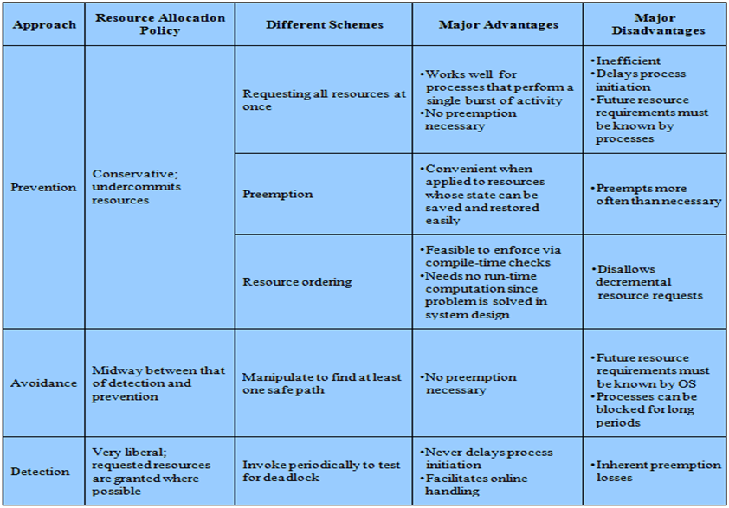
Advantages and Disadvantages

Slide 30
Thank You!

